Slide 1

INSTITUTE OF ADVANCED COMPUTING AND SOFTWARE DEVELOPEMENT
Online Bus Booking System
Project Mentor
Mr. Kashinath Patil
Project By
Mukesh Dhadekar (219057)
Suraj Biradar (219049)

Slide 2
Introduction
Most of the people are buying tickets offline, by visiting the counters of that particular company and getting into queues and paying through cash system and hence wasting time and having money exchange problem and taking into consideration this things online bus booking system takes into consideration that we will provide online ticket without having problem of time getting wasted and using the system of online payment they solve the problem money exchange and carrying cash along with them and we have also provided some of the additional facilities like bus enquiry, ticket enquiry etc.

Slide 3
Technology
Front End Tools : Asp.net , C#, CSS,Javacript. Back End Tool : SQL Server Operating System : Microsoft windows 10 Web Server : IIS Web Browser : Microsoft Edge Editor : Visual studio Hardware : 64-bit processor, 1.70 GHz,
Ram : 4GB

Slide 4
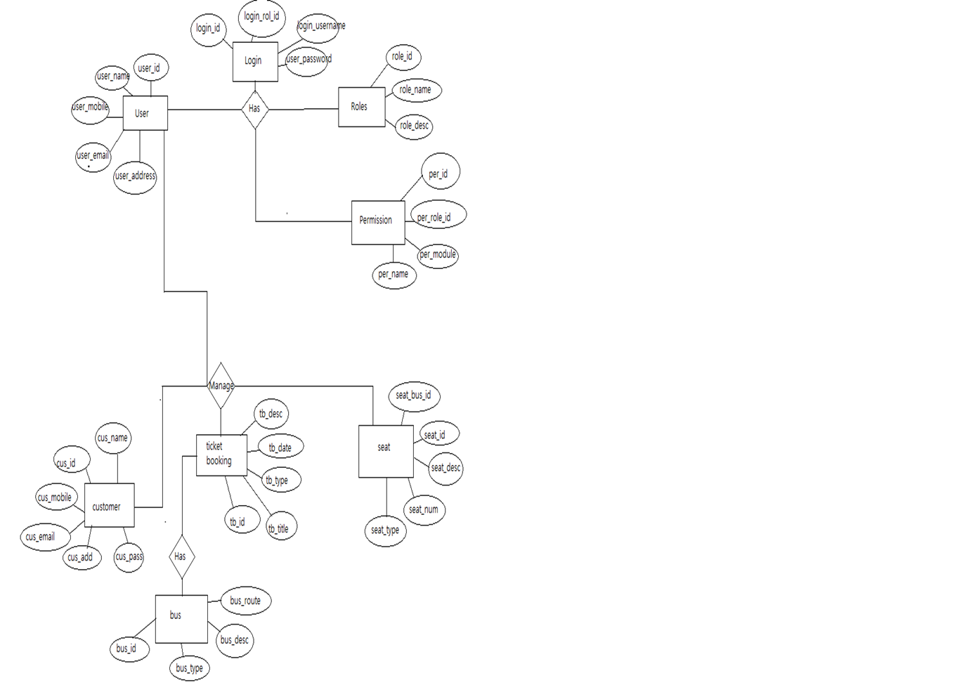
E-R Diagram

Slide 5
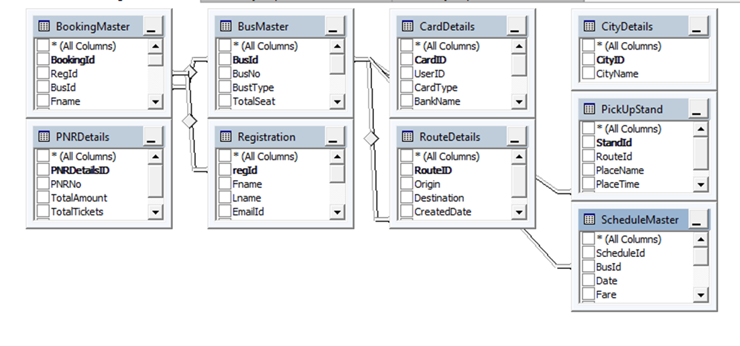
Data Tables

Slide 6
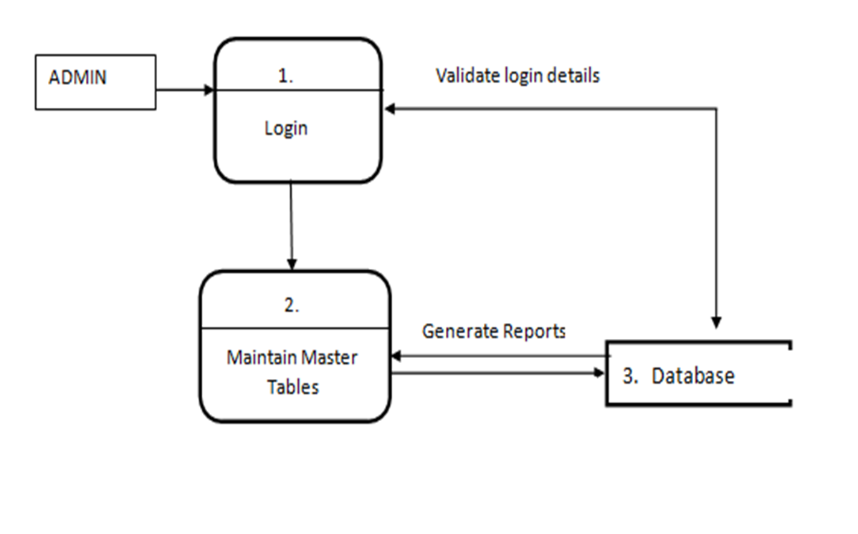
Anmin Panal

Slide 7
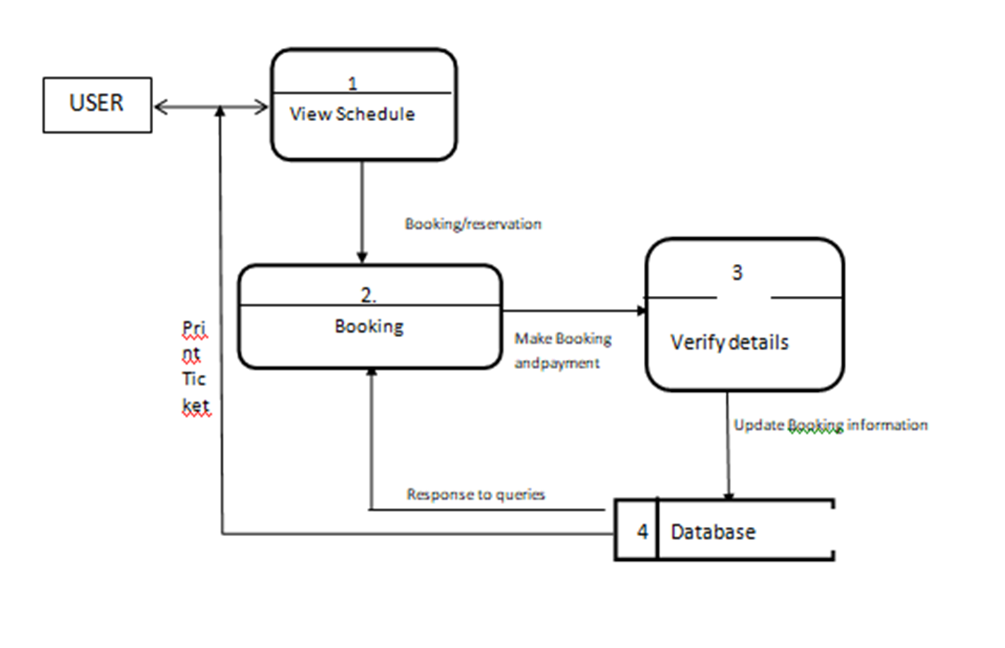
Uer Panel

Slide 8
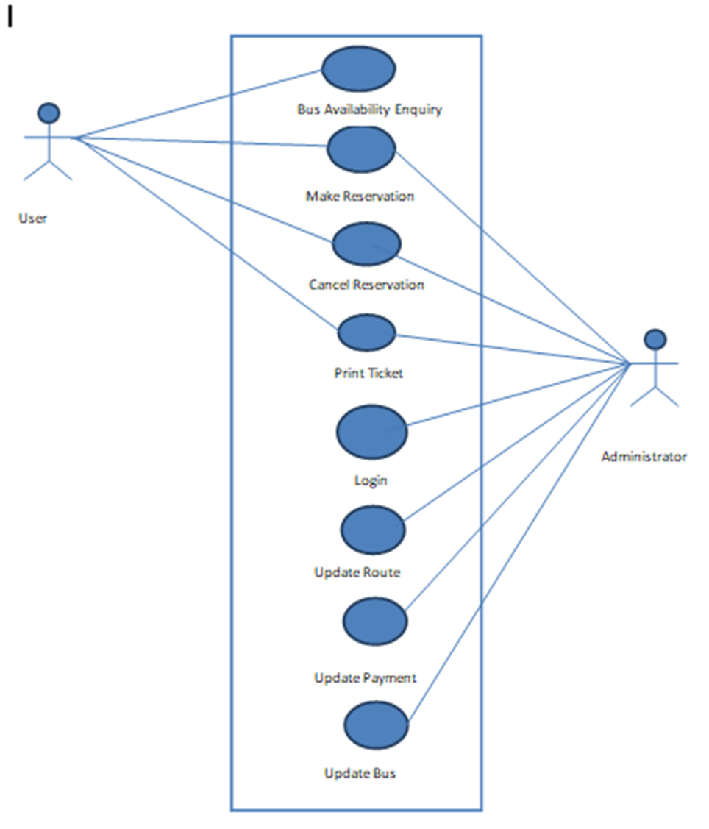
Use Case Diagram

Slide 9
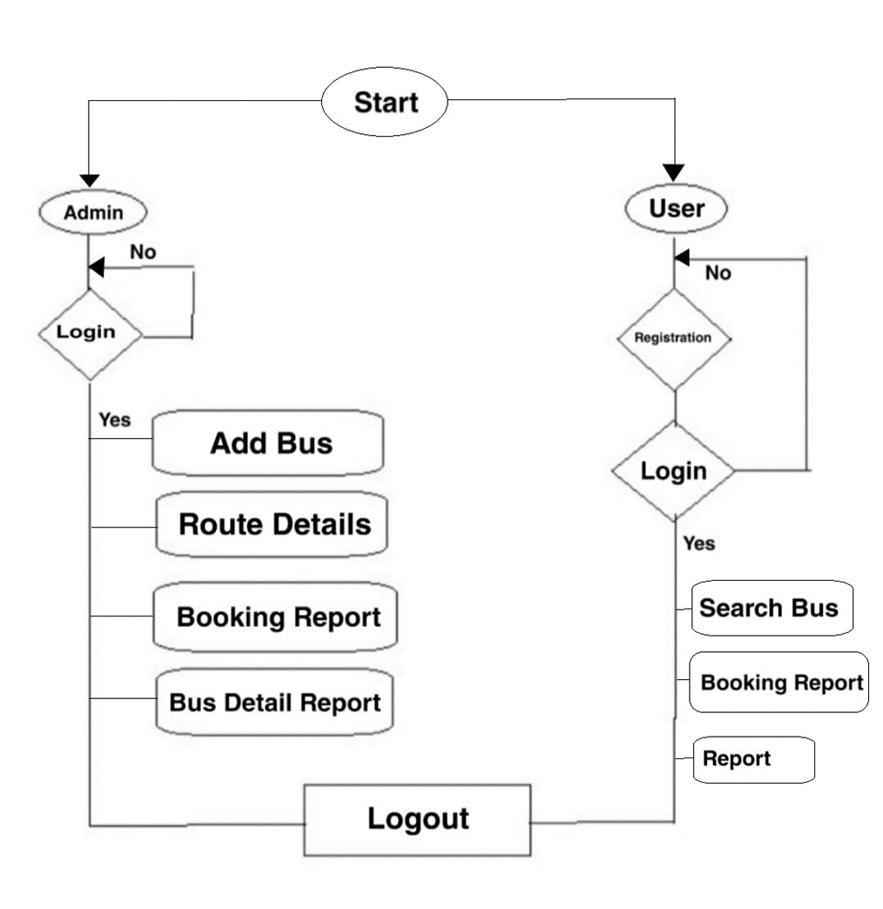
Flowchart

Slide 10
Modules
Administrator
User

Slide 11
Screenshots...

Slide 12
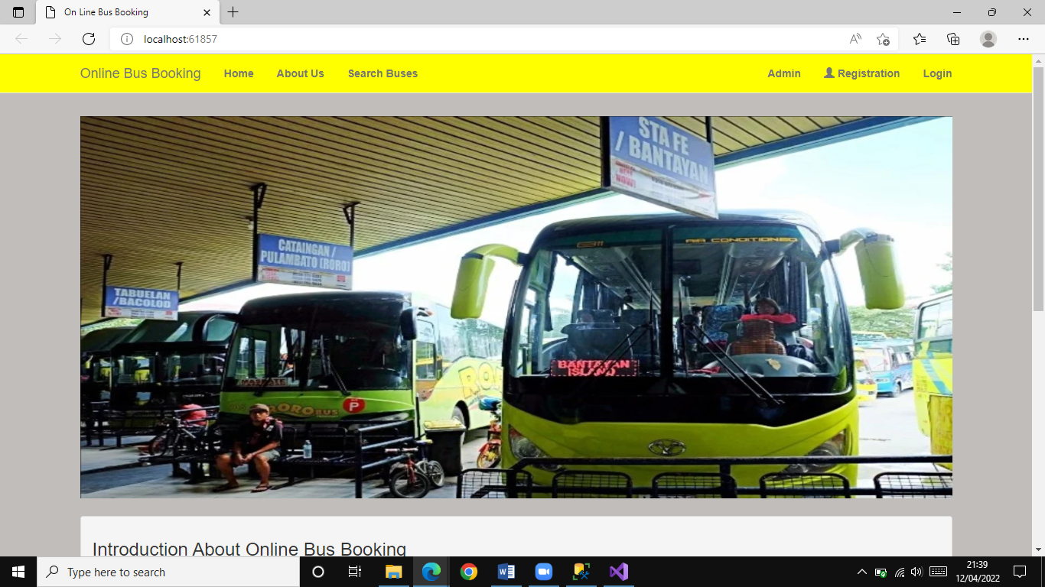
Home page

Slide 13
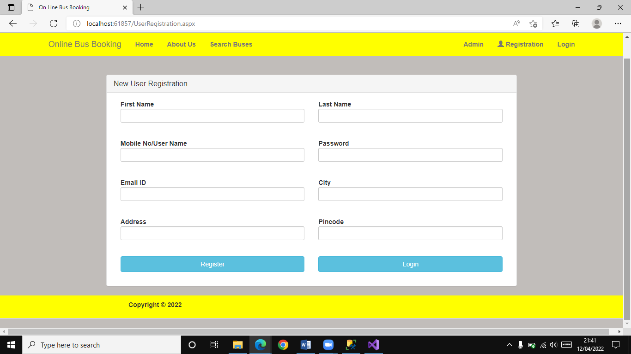
Registration page For New user creation

Slide 14
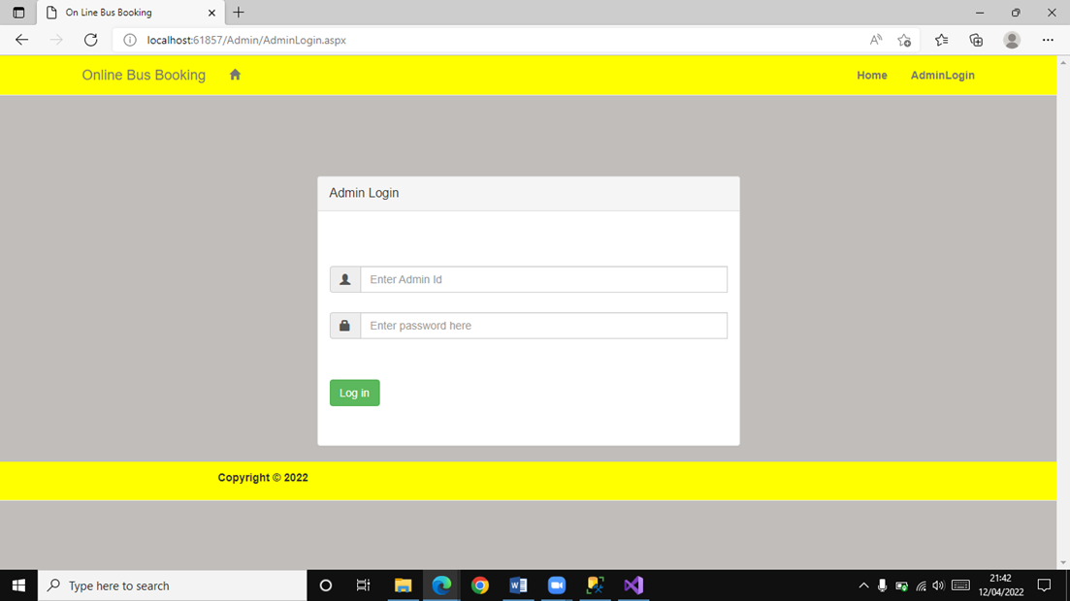
Admin Login

Slide 15
Administrator view
Screenshots...

Slide 16
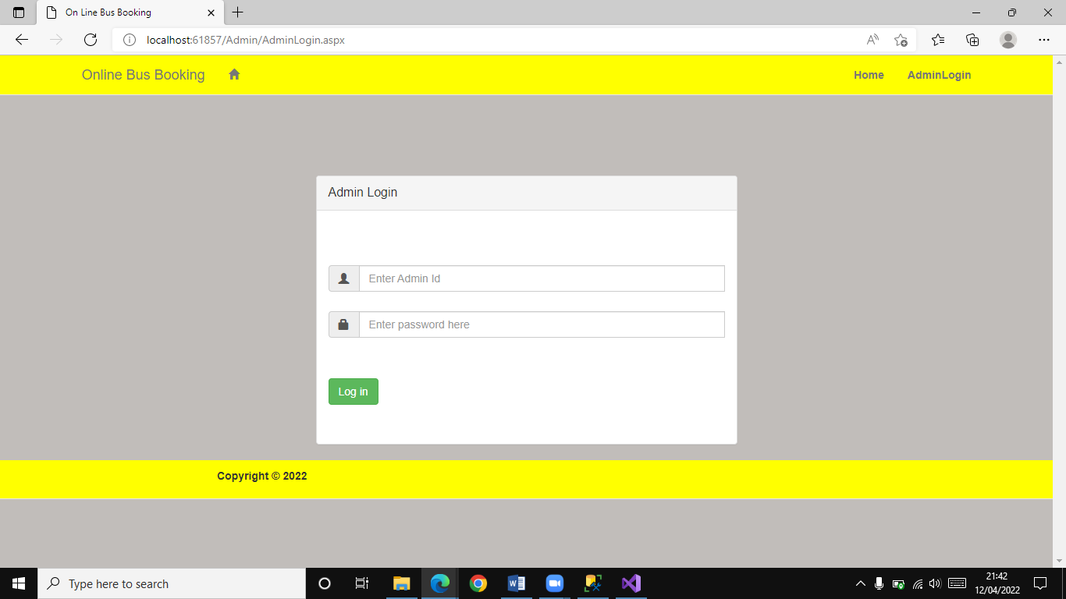
Adding Bus Details

Slide 17
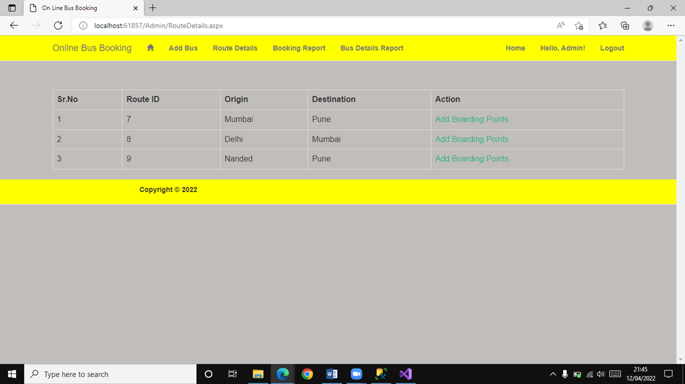
Route Details

Slide 18
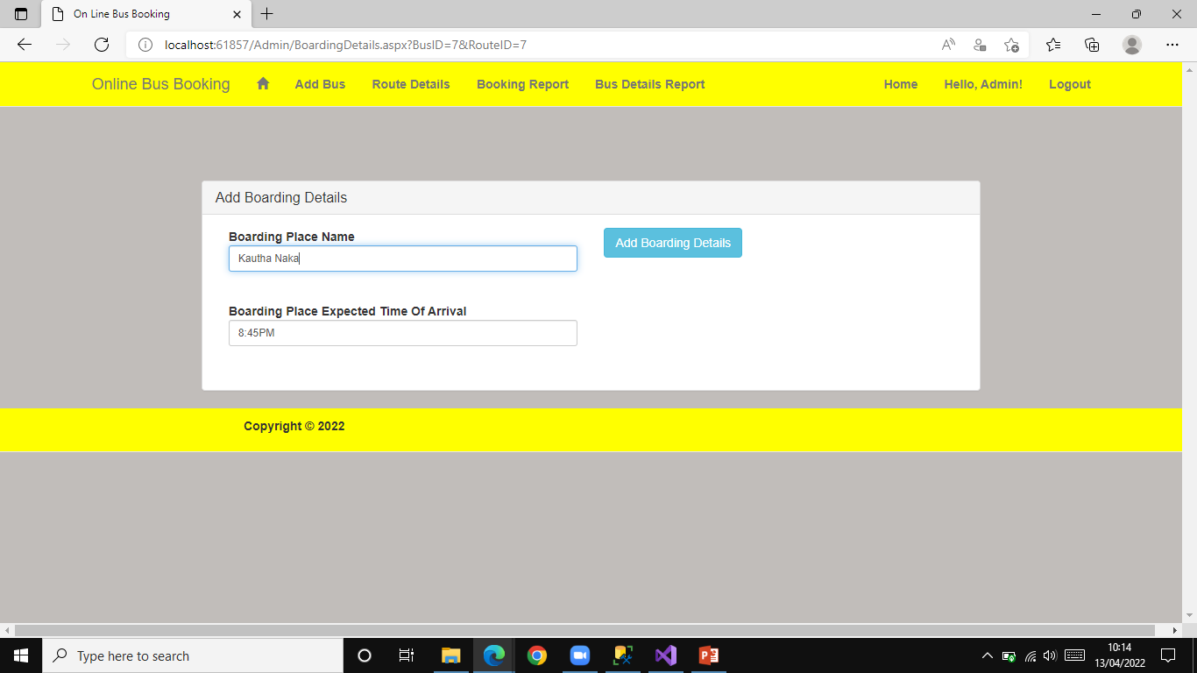
Adding Boarding Point

Slide 19
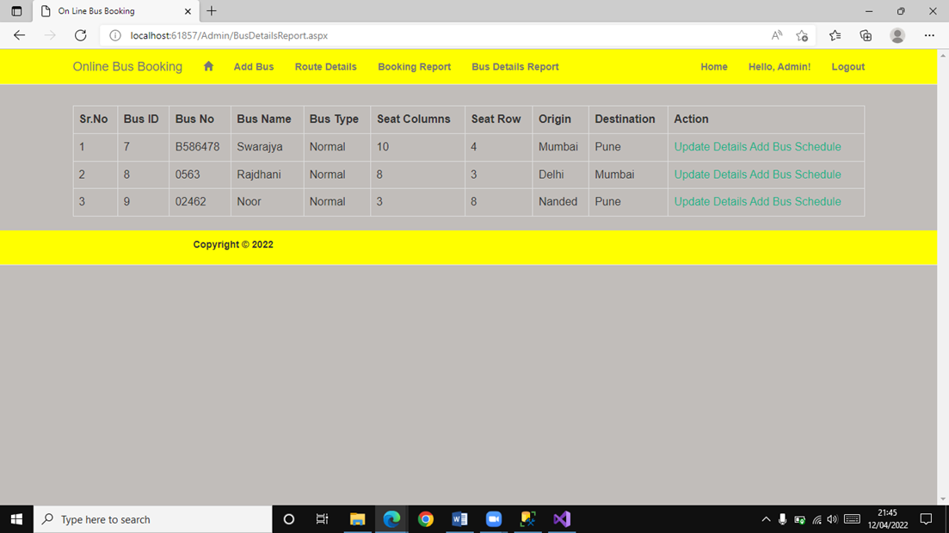
Bus Details Report

Slide 20
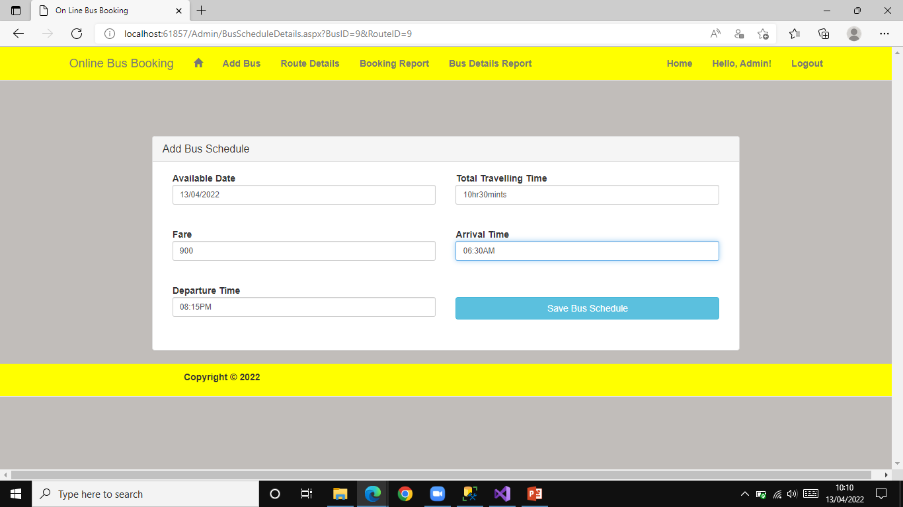
Adding Bus Schedule

Slide 21
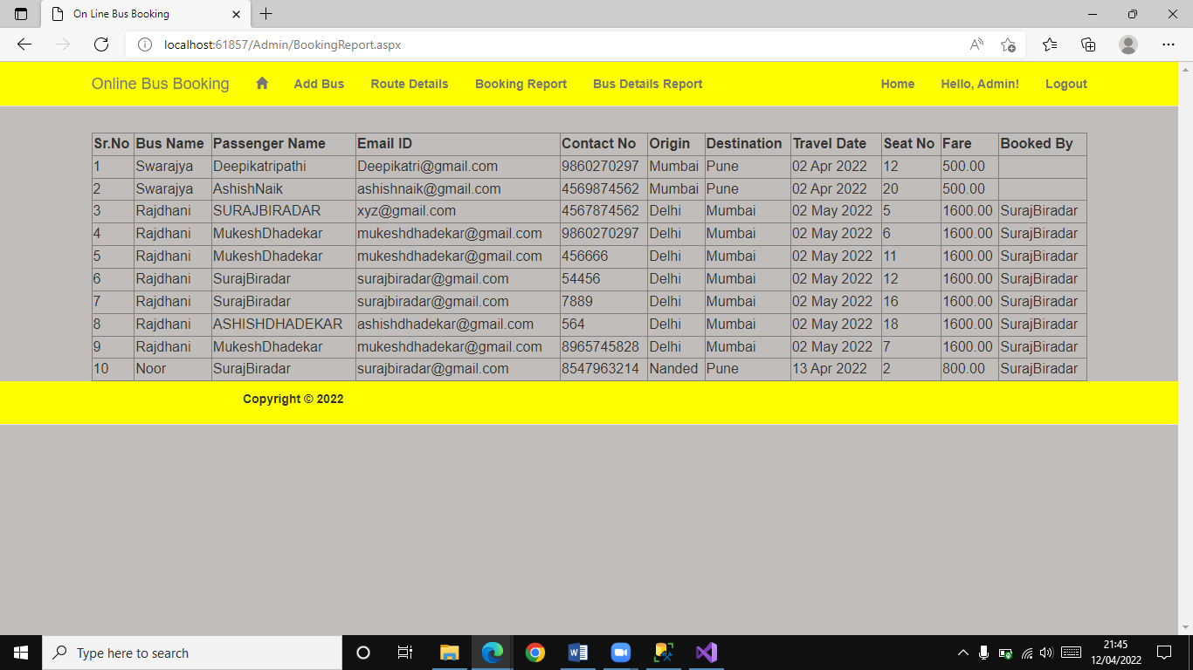
Booking Report

Slide 22
Registered User view
Screenshots...

Slide 23
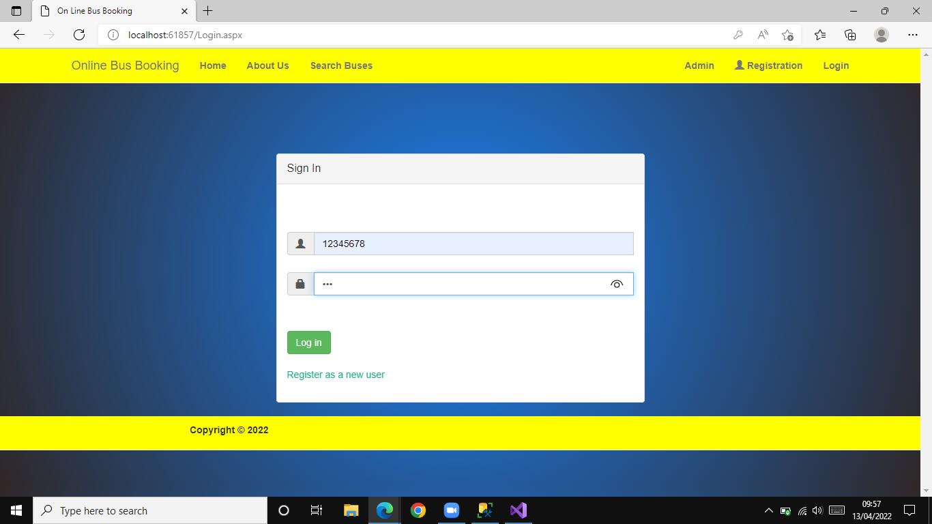
Registered User Login

Slide 24
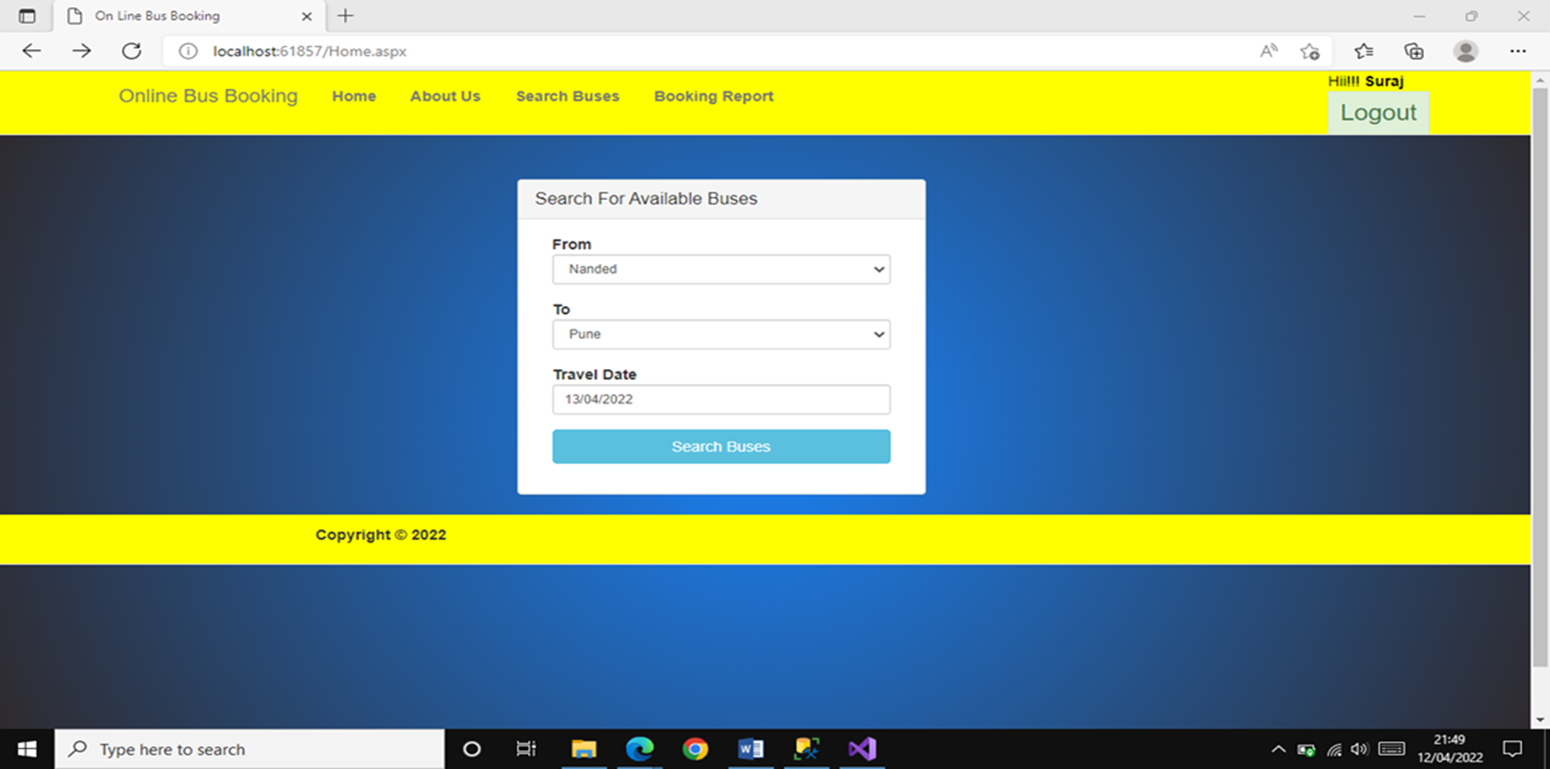
Registered User Search bus

Slide 25
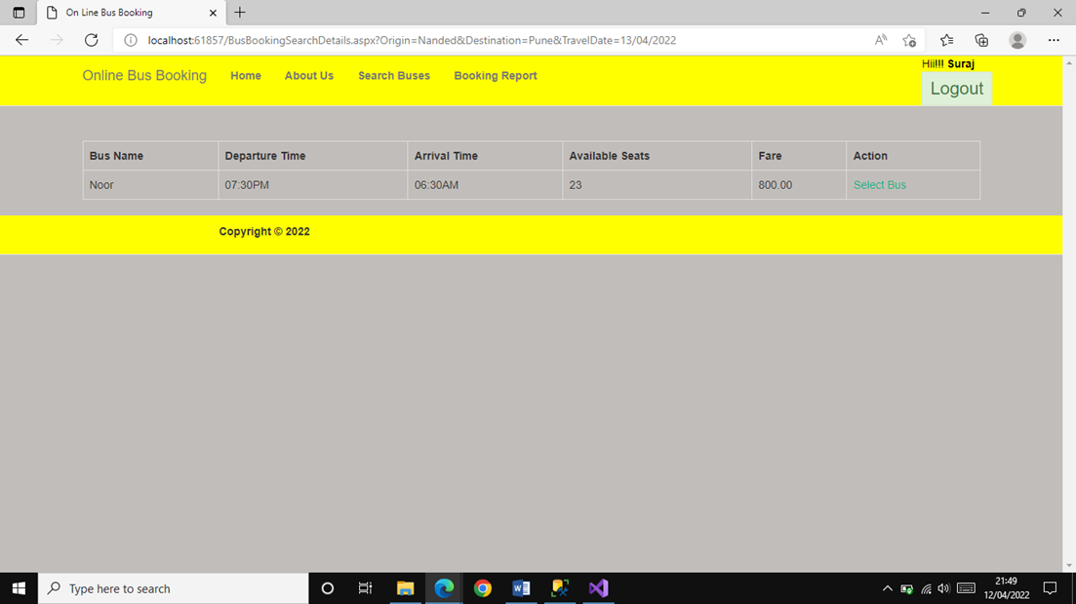
Available Bus for booking

Slide 26
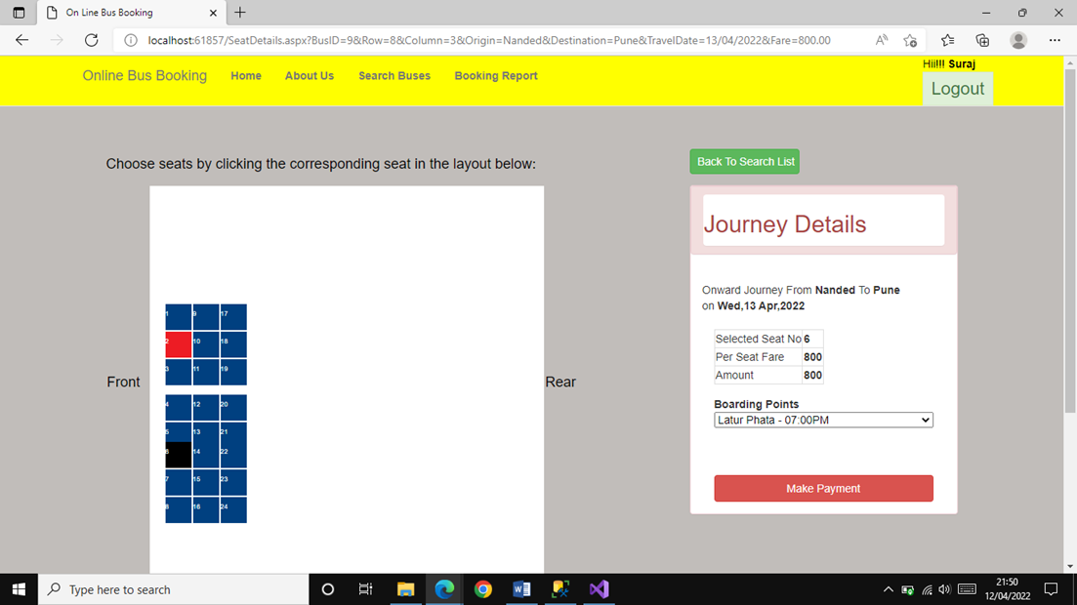
Seat selection and other details

Slide 27
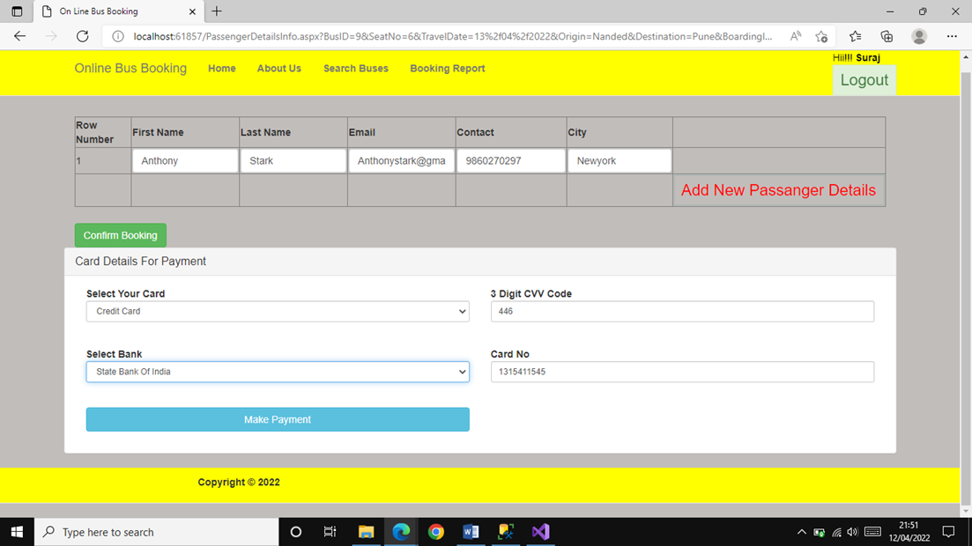
Passenger details and payment

Slide 28
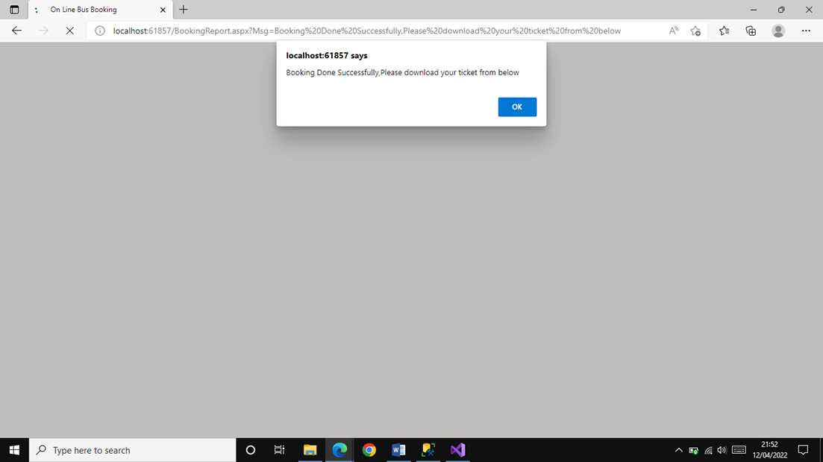
Booking confirmation

Slide 29
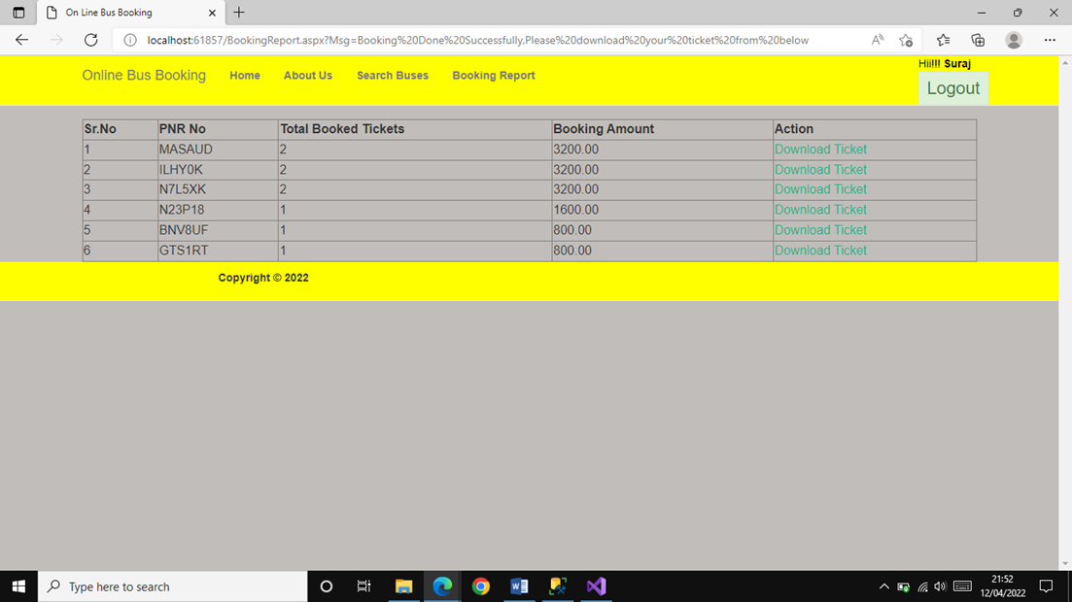
Ticket Generation

Slide 30
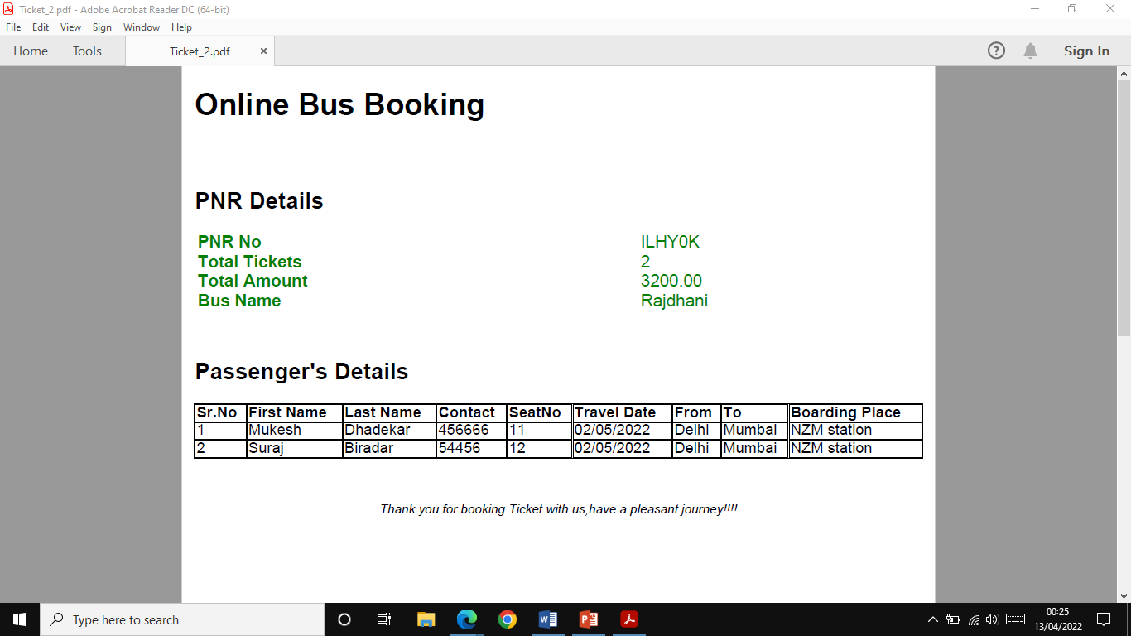
Printed Ticket

Slide 31
Reference
Project Idea | Online Bus booking report- GeeksforGeeks
https://www.geeksforgeeks.org
https://stackoverflow.com
https://www.wikipedia.org

Slide 32
Thank You

